Slide 1
Utilizing Additional Data Sources to Improve National Representative Estimates on Patient Care in Hospitals
National Center for Health Statistics
Geoff Jackson M.S., National Center for Health Statistics
August 7, 2024
2024 Joint Statistical Meeting
Disclaimer: All views expressed in this manuscript are those of the author, and do not necessarily reflect those of the Centers for Disease Control and Prevention or National Center for Health Statistics.

Slide 2

Project Goal
Utilize statistical modeling and additional data sources to produce the first ever national estimates and public use file on hospital discharges and emergency department visits from the National Center for Health Statistics’ National Hospital Care Survey.

Slide 3
Contributions
NORC
Jay Breidt
Chris Cox
Scott Campbell
Edward Mulrow
Dean Resnick
Jennifer Taub
NCHS
Yulei He
Donielle White
Guangyu Zhang

Slide 4
National Hospital Care Survey Background

Slide 5
National Hospital Care Survey (NHCS)
Survey’s Goal:
Provide reliable and timely healthcare utilization data for hospital-based settings.
Data coverage:
Stratified probability sample of 608 non-institutional, non-federal hospitals with six or more staffed inpatient beds.
Sample strata defined by hospital type, bed size, and urban/rural designation.
Administrative data collection of all hospitalizations and emergency department (ED) visits for a calendar year.
Includes patient personally identifiable information (PII) so patient as well as encounter level counts can be determined.

Slide 6
NHCS Data Sources
Uniform Billing (UB)-04 administrative claims
Accepted electronic standard for hospital billing.
Mandated by the Centers for Medicare and Medicaid Services (CMS) for payment of charges for Medicare and Medicaid recipients.
Electronic health record (EHR) data
Pulls medical information from multiple sources (e.g., labs and medications).
More clinical depth and breadth.
HL7 CDA® R2 Implementation Guide (IG): National Health Care Surveys Release 1, DSTU Release 1.2 - US Realm, provides a standardized format for data submission.

Slide 7
2020 NHCS Data Background
Data elements:
Patient PII, patient’s age and sex
Diagnoses and procedures (UB-04: up to 25 codes, EHR: Unrestricted)
Discharge status
Insurance information
Number of records:
205 hospitals provided data
2,781,542 inpatient discharges and 7,960,956 ED visits

Slide 8
Number of Hospitals Providing Data by Year

Slide 9
Weighted Estimates of Inpatient Discharges and ED Visits

Slide 10
Producing NHCS Weighted Estimates
Issue
To produce national estimates NCHS relied on a method for weighting the NHCS data that utilized the original sampling strata.
Due to low participation rates the original weighting method produced unreliable national estimates.
Solution
NCHS partnered with NORC to implement a modeling-based weighting methodology that utilized third-party data sources to produce reliable national estimates on hospital utilization.

Slide 11


Third-Party Hospital Data Sources

Slide 12
Premier Healthcare Database
Premier Inc. is a healthcare improvement company that creates the Premier Health Database (PHD), a nonprobability collection of inpatient and ED data from more than 1,100 hospitals.
A commercially available database of deidentified hospital encounter level data from geographically diverse non-profit, non-federal community and teaching hospitals.
Includes data on hospital characteristics, diagnoses, procedures, discharge status, patient age, sex, and race/ethnicity.
The PHD can not be used in public use files or in restricted use files available to the public through the Research Data Center.

Slide 13
Agency for Healthcare Research and Quality’s (AHRQ) Healthcare Cost and Utilization Project (HCUP)
The Healthcare Cost and Utilization Project (HCUP) is a family of databases developed through a Federal-State-Industry partnership and sponsored by AHRQ. (https://www.ahrq.gov/data/hcup/index.html)
Deidentified UB-04 claims data from U.S. community hospitals, excluding rehabilitation and long-term acute care hospitals.
Diagnoses, procedures, discharge status, and patient demographics data.
National Inpatient Sample (NIS)
47 states provided data on 7 million unweighted hospital stays.
National Emergency Department Sample (NEDS)
39 states provided data on 30 million unweighted ED visits.

Slide 14
Challenges
NHCS is a probability sample and PHD is a non-probability sample.
NHCS has potential for differential nonresponse.
PHD has potential differential participation.
Deidentified hospitals in PHD and HCUP.
Cannot directly link the PHD and HCUP data to NHCS.
Cannot identify NHCS responding hospitals in PHD or HCUP.

Slide 15
Weighting Methodology

Slide 16
1. Compute Weights for NHCS and Premier
Compute NHCS weights (N_wght) that reflect its original stratified sample design and Premier weights (P_wght) with estimate response propensities from a model fitted via a likelihood-based approach.
The model assumes that the logit (log odds) of response propensity is a linear function of the covariates. A likelihood-based procedure is used to estimate the parameters of the logistic response propensity model. The likelihood is non-standard, and the covariates are entirely discrete creating a custom, weighted data set to fit the logistic model.
To account for differential nonresponse the response propensity were estimated for NHCS and Premier. HCUP data were used to obtain population-level summaries for estimation of the propensity models.
Notes:
Weights based on sampling rate within each stratum (number of beds, type of hospital, urban/rural designation)
For these models, the covariates are as follows:
General Acute Care (GAC) IP (NHCS and Premier):
Hospital Region
Bed Size: 1 – 99, 100 – 299, 300 – 749, 750+
Percentage of Patients on Medicaid: 0 – 10%, 10 – 25%, > 25%
Percentage of Patients who are Seniors: 0 – 40%, 40- 52.5%, >52.5%
Emergency Department (ED) (NHCS and Premier):
Hospital Region
Urbanicity: Urban or Rural
Encounter Count: < 15,000, 15,000 – 29,999, 30,000 – 100,000, > 100,000
Percentage of Patients on Medicaid: 0 – 10%, 10 – 25%, > 25%

Slide 17
2. Combine NHCS and Premier datasets and create a combined hospital-level weight
Since it is not possible to identify hospitals that appear in NHCS and Premier databases, this rules out certain classes of estimators and requires assumptions to enable variance estimation.
For point estimation, a separate dual-frame estimator was used by choosing a parameter (λ=0.5) and a hospital-level combined weight was constructed. The formulas used for calculating the combined weighted are:
Summing the weights across all encounters in all hospitals gives the estimated number of hospital visits for the year.
 | NHCS | Premier
366 days of data | λ x N_wght | (1-λ) P_wght
< 366 days of data | λ x N_wght x (366/# Days) | (1-λ) P_wght x (366/# Days)

Slide 18
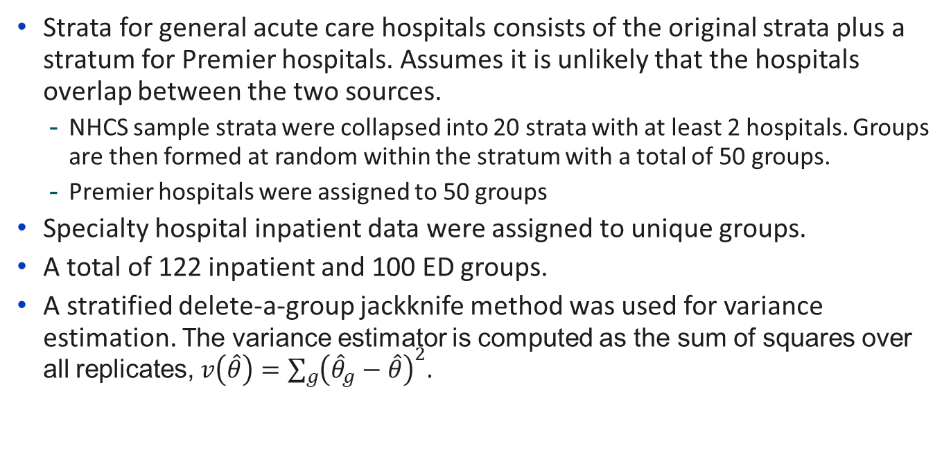
3. Create a replicate combined weight for variance estimation
Strata for general acute care hospitals consists of the original strata plus a stratum for Premier hospitals. Assumes it is unlikely that the hospitals overlap between the two sources.
NHCS sample strata were collapsed into 20 strata with at least 2 hospitals. Groups are then formed at random within the stratum with a total of 50 groups.
Premier hospitals were assigned to 50 groups
Specialty hospital inpatient data were assigned to unique groups.
A total of 122 inpatient and 100 ED groups.
A stratified delete-a-group jackknife method was used for variance estimation. The variance estimator is computed as the sum of squares over all replicates, $v\left(\hat{θ}\right)=\sum_{g}{{\left({\hat{θ}}_{g}−\hat{θ}\right)}^{2}.}$
Notes:
We have made three choices in the variance estimation that lead to larger variance estimates and wider confidence intervals, in partial compensation for the untestable independence assumption noted above. First, we drop finite population corrections in the computation of the variance from the stratified NHCS sample, a standard approach to conservative variance estimation. Second, we drop a multiplicative constant that is close to but less than one from the computation of the jackknife variance estimator. Third, we compute the jackknife variance estimator as the sum of squares around the full-sample estimator instead of around the average of the jackknife replicate estimators.

Slide 19
4. Create NHCS calibrated weights
The combined data served as a control total to calibrate the NHCS-only data to the key national estimates.
An iterative proportional fitting raking method was used in the calibration effort.
The NHCS calibrated weights are at the encounter-level and vary as little as possible within hospitals.

Slide 20
Results and Data Access

Slide 21
Final estimates of 2020 NHCS Admissions and ED Visits
Setting | Number of Encounters | Standard Error
Inpatient | 36,342,461 | 2,173,127
Emergency Department | 114,561,914 | 5,631,753
Data Source: 2020 National Hospital Care Survey restricted use file, National Center for Health Statistics

Slide 22
NHCS Restricted Use Files
https://www.cdc.gov/rdc/b1datatype/Dt1224h.htm
Weighted final data: 2020
Unweighted final data: 2013-2016, 2019, 2021
Preliminary data: 2020-2023
Linked 2016 Data: National Death Index, CMS, HUD, and VA
Enhanced drug data:
Opioid-involved: 2016, 2019, 2020, 2021
Opioid-involved with co-occurring substance use disorders and mental health issues: 2016, 2019, 2020, 2021
Submit an RDC request: https://www.cdc.gov/rdc/index.htm

Slide 23
NHCS 2020 Public Use File Access
https://www.cdc.gov/nchs/nhcs/2020nhcs.htm
Inpatient and ED files available in the following formats:
SAS
R
Stata
Encounter level data on patient age, sex, discharge month, discharge status, up to 30 diagnoses codes, length of stay (inpatient only), and up to 10 procedure codes (inpatient only).

Slide 24


New Project Announcement
With funding from the Patient-Centered Outcome Research Trust Fund, development is underway on a new enhanced algorithm to improve the identification of stimulants in the NHCS data. The algorithm will utilize natural language processing techniques in the analysis of clinical text.
Additionally, the project involves construction of a dashboard to display results from the weighted 2020 NHCS data with a focus on drug-involved visits.

Slide 25
Contact Information
Geoff Jackson
Email: gjackson@cdc.gov

